Slide 1

State of the city
Mayor Susan Haynie
Federation of Boca Raton Homeowners Associations
June 7, 2016

Slide 2
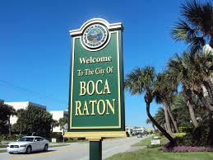

Welcome to Boca Raton

Slide 3
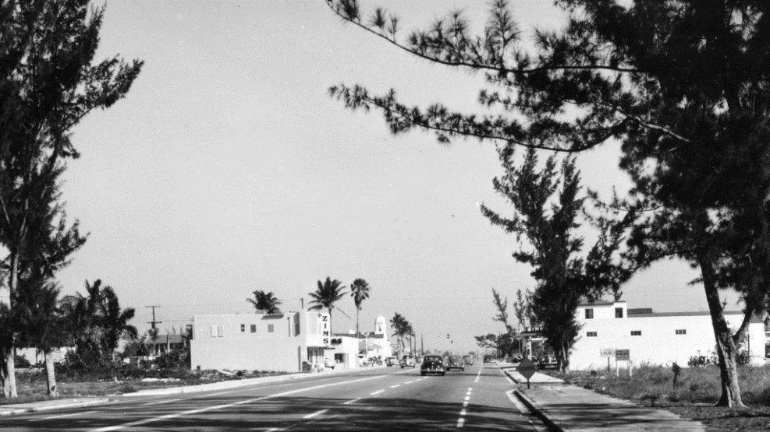
Where we came from

Slide 4
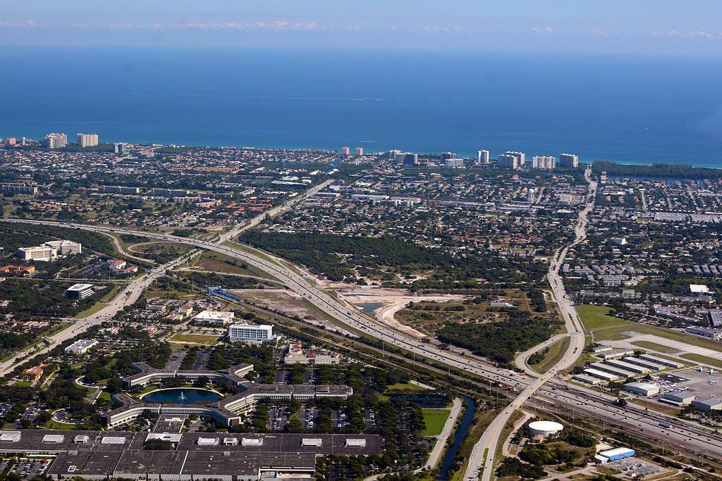
Where we are today

Slide 5
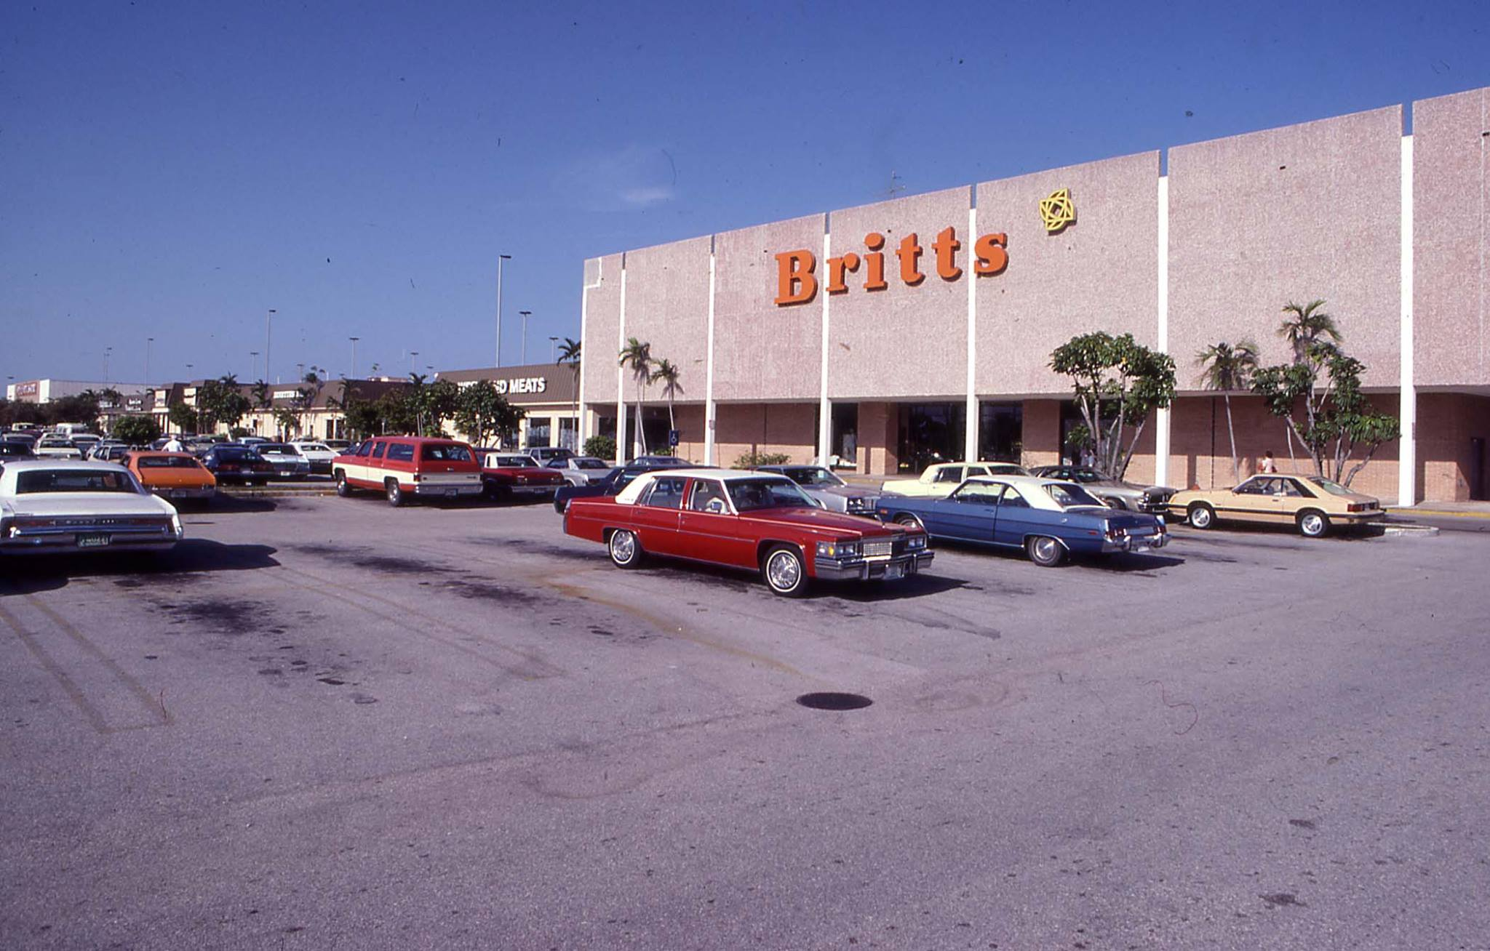
Then….

Slide 6
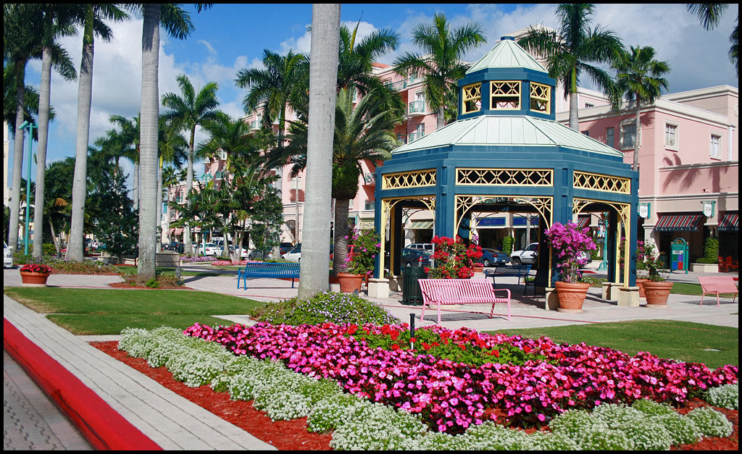
Now…

Slide 7
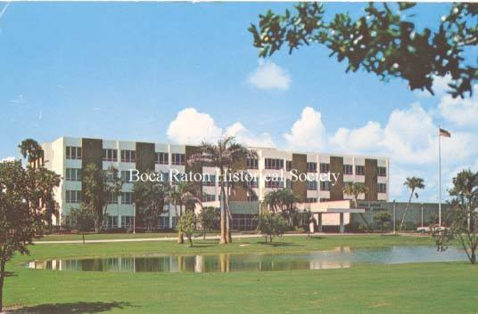
Then…

Slide 8
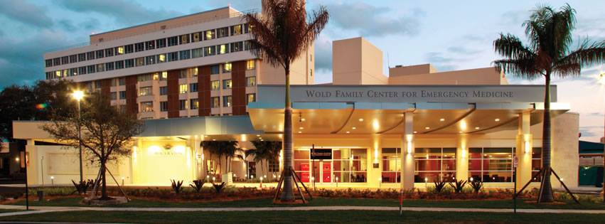
Now…

Slide 9
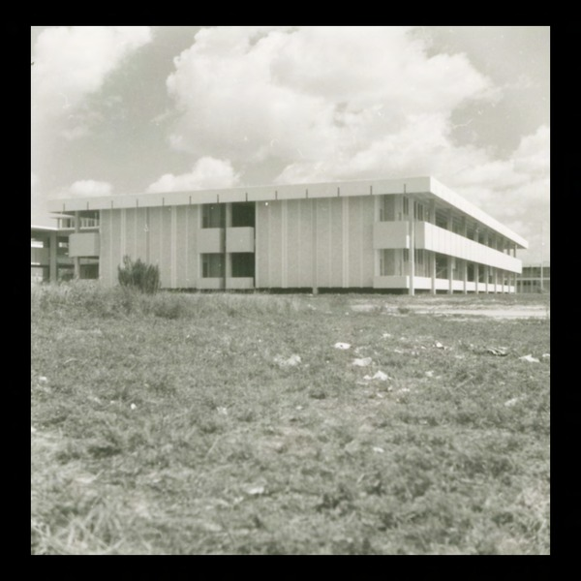
Then…

Slide 10
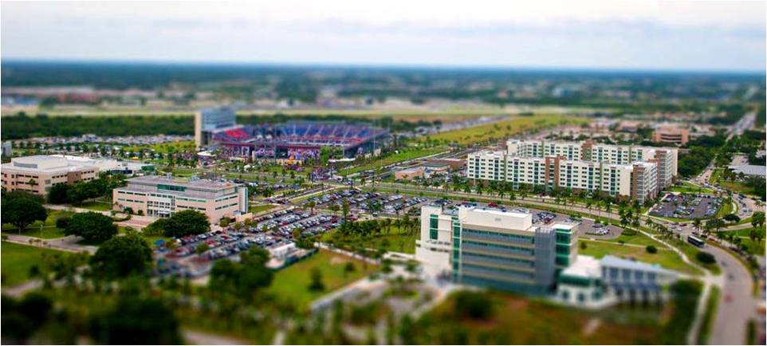
Now…

Slide 11
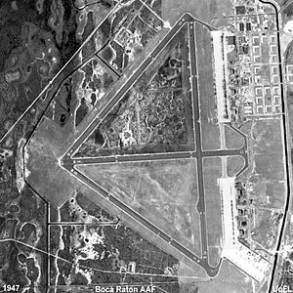
Then…

Slide 12
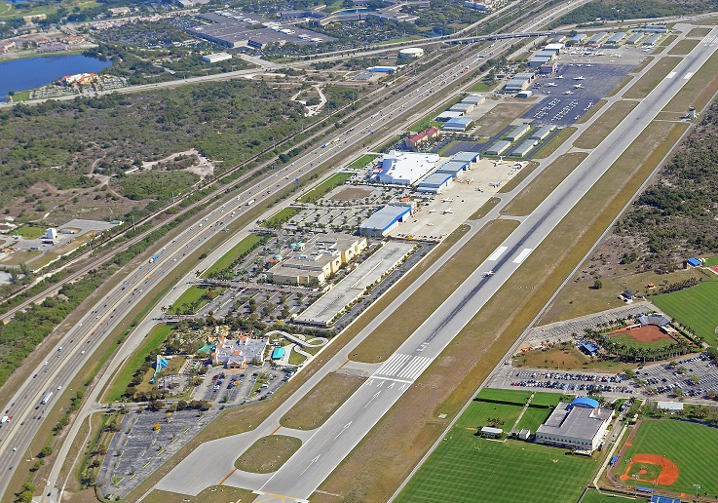
Now…

Slide 13
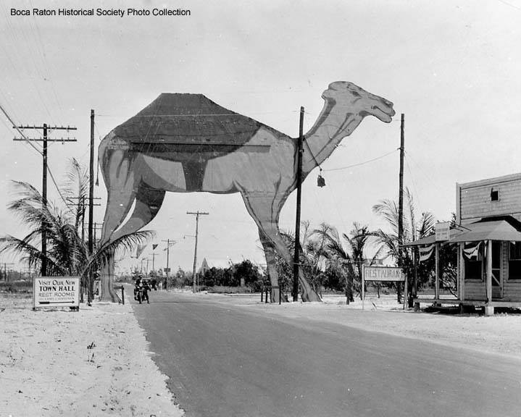
Then…

Slide 14
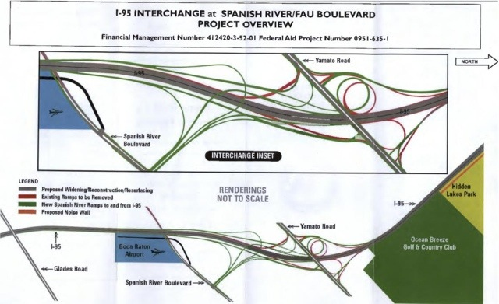
Now…

Slide 15
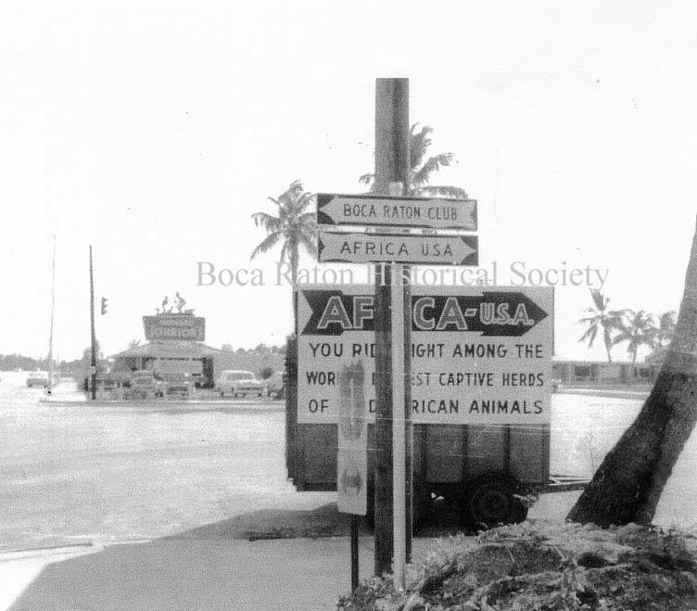
Then…

Slide 16
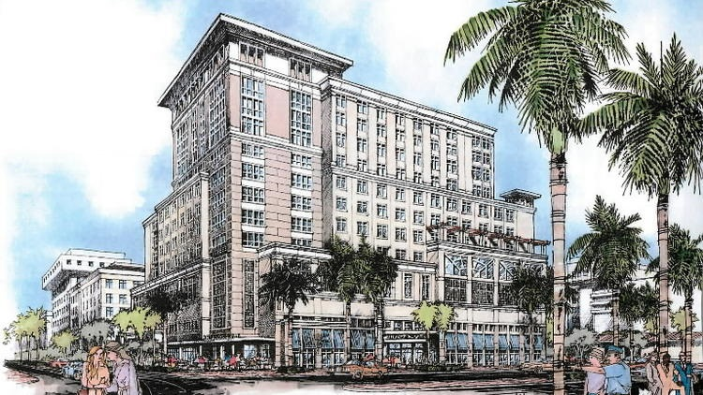
Now…

Slide 17
City Issues Then….
“…traffic flow, speed limits, zoning, high-rise apartments, architectural review standards which relate to community appearance, disposal of city-owned land and parking problems in Downtown business area.”
Boca Raton News, March 3, 1966

Slide 18
City Issues Today…
“…traffic flow, speed limits, zoning, high-rise apartments, architectural review standards which relate to community appearance, disposal of city-owned land and parking problems in Downtown business area.”

Slide 19
Statistics
Population – 93,235
Property Value Increase of 6.7% This Year
Assessed Value of $21 Billion
AAA Bond Rating All Agencies
Office Space – 12 Million Square Feet
Corporate Headquarters in PBC 62 – 30 in Boca Raton

Slide 20
Accomplishments 2015-2016
Communications position and plan instituted
Economic Development plan instituted, leveraging $4.3 million investment into $14.2 million incentives
Created and retained over 8,400 jobs
Boca Raton Bowl - $10.4 million economic impact with 2.5 million viewers
Festival of the Arts- sold out performances
Development Process Improvement Plan( permits & planning)
Airport Strategy Implemented
Relations with Police & Fire

Slide 21
Boca Raton’s Vision
Boca has Great Neighborhoods and a Vibrant Downtown that are beautiful by design. Boca Raton is a Global Economic Center. Our residents enjoy Beaches and Waterways, Arts and Culture and High Quality Recreation Opportunities.
We are a Premier Community.

Slide 22
City of Boca Raton Goals for 2020
World Class Municipal Services
Financially Sound City
Vibrant and Sustainable City
Strong Partnership with Community

Slide 23
TOP Priorities 2016-2017
City Campus Master Plan/Evaluation & Report
Wildflower Decision
Comprehensive Waterfront Plan
20th Street Area Conceptual Master Plan
Beach and Park District Agreement
Lake Wyman Park

Slide 24
HIGH Priorities 2016-2017
Downtown Traffic Alternative Study
Downtown Design Tool Guide
Red Reef Park Master Plan
Downtown Open Space Policy
Florida Atlantic University & Campus Agreement
Rental Housing Registration and Inspection Program

Slide 25
Priorities in Action Plan
Wildflower
Annexation
Downtown Traffic Alternative Study
Rental Registration Program
Downtown Open Space Policy
Comprehensive Waterfront Plan

Slide 26


Stay Connected
Visit MyBoca.us to report concerns, pay bills, sign up for alerts
Use MyBocaLink.com as a resource for press releases & photos
Like us on Facebook AND Follow us on Twitter
Check out videos on BocaTV
Sign up for monthly E-News
Check the City’s home page for News & Information
Attend CRA, Workshop and Council Meetings
Watch Live on Channel 20 or Online
Attend Community Advisory Panel Meetings
Share concerns and initiatives

Slide 27
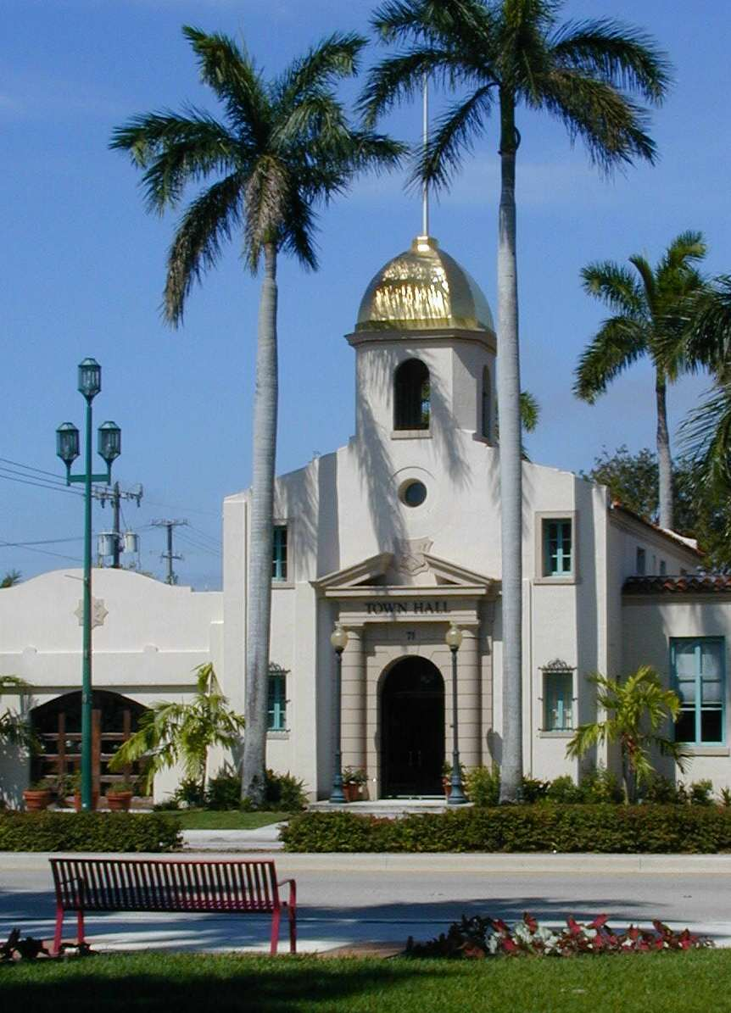
Thank You. Questions?

